Slide 1
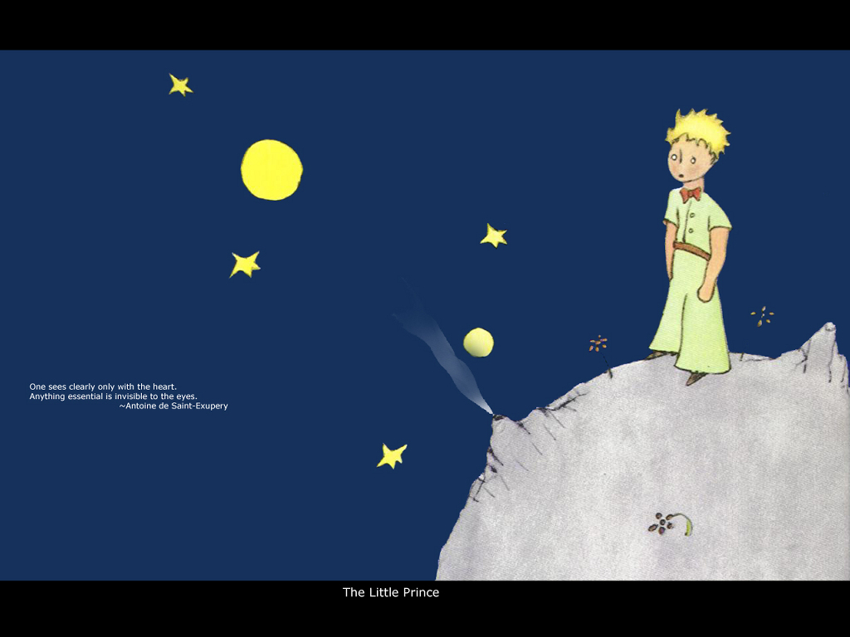
The Little Prince

Slide 2
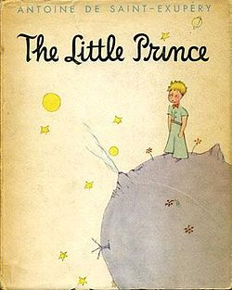
Background Information
The Little Prince (French: Le
Petit Prince; first published in
1943(when he exiled in the United
States after the Fall of France,), is
a novella and the most famous
work of the French aristocrat, writer,
Poet and pioneering aviator Antoine
de Saint-Exupery (1900–1944).

Slide 3
Background Information
The Little Prince is both the most read and most translated book in the French language, and was voted the best book of the 20th century in France. Translated into more than 250 languages and dialects, and selling over a million copies per year with sales totaling more than 140 million copies worldwide, it has become one of the best-selling books ever published.

Slide 4
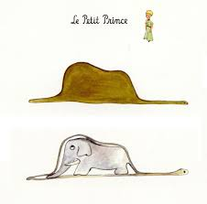
The Plot
The narrator, as a young boy, once drew a picture of a boa constrictor eating an elephant; however, every adult who saw the picture would mistakenly interpret it as a drawing of a hat. He was then advised to set aside drawing and take up a more practical hobby. Adults' lack of creative understanding.

Slide 5
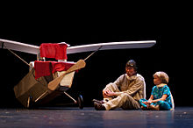
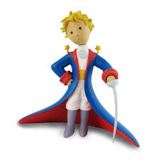
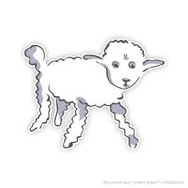
The Plot (con.)
Now, an adult himself, the narrator has become a pilot, and, one day, his plane crashes in the Sahara desert, far from civilization. Here, he is suddenly greeted by a young boy or small man whom he refers to as "the little prince". The little prince asks the narrator to draw a sheep.

Slide 6
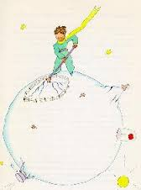
The Plot (con.)
Over the 8 days stranded in the desert, as the narrator attempts to repair his plane, the little prince recounts the story of his life. The prince lives on a tiny planet: an asteroid the size of a house (which the narrator believes to be the one known as B 612). 3 minuscule volcanoes (2 active, 1 extinct) and a variety of plants.

Slide 7
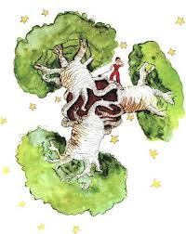
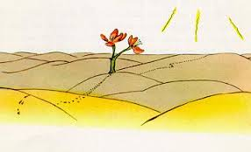
The Plot (con.)
The prince describes spending his earlier days pulling out baobab trees that are constantly trying to grow and overtake the surface. The prince appears to want a sheep to eat such undesirable plants, until the narrator informs him that a sheep will even eat roses with thorns.

Slide 8
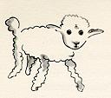
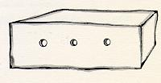
The Sheep Episode (Ch. II)
You can imagine my amazement, at sunrise, when I was awakened by an odd little voice. It said: "If you please--draw me a sheep!"
"What!"
"Draw me a sheep!"

Slide 9
Childhood vs. Adulthood
“All grown-ups were once children... but only few of them remember it.”
“The Child is Father of the Man” (from My Heart Leaps Up
by William Wordsworth)
IMAGINATION!

Slide 10
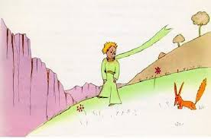
The Prince encounters the Fox

Slide 11
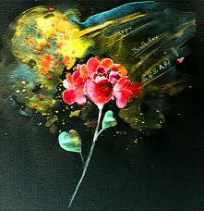
Teaching from the Fox
“People have forgotten this truth," the fox said. “But you mustn’t forget it. You become responsible forever for what you’ve tamed. You’re responsible for your rose.” (XXI)
“It is the time you have wasted for your rose that makes your rose so important.”

Slide 12
Teaching from the Fox (con.)
The little prince added, "But eyes are blind. You have to look with the heart.”
“The most beautiful things in the world cannot be seen or touched, they are felt with the heart.”

Slide 13
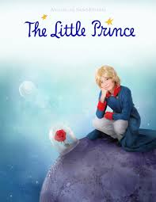
Teaching from the Fox (con.)
“One sees clearly only with the heart. Anything essential is invisible to the eyes” (XXI).

Slide 14
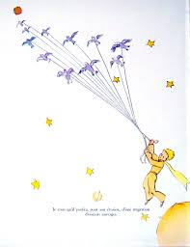
The End

Slide 15
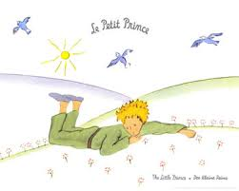
Thank you!
Q & A

